Slide 1
A MACHINE LEARNING APPROACH FOR RECOGNIZING INTELLECTUAL DEVELOPMENT DISORDER USING EEG

Slide 2
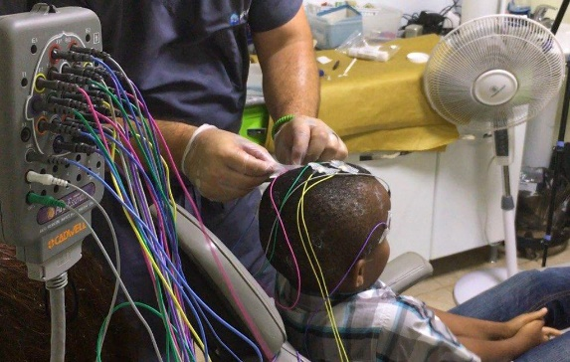
EEG: An Overview
Electroencephalography is a method to record an electrogram of the spontaneous electrical activity of the brain by connecting electrodes to the scalp. The biosignals detected by EEG have been shown to represent the postsynaptic potentials of pyramidal neurons in the neocortex and allocortex.

Slide 3
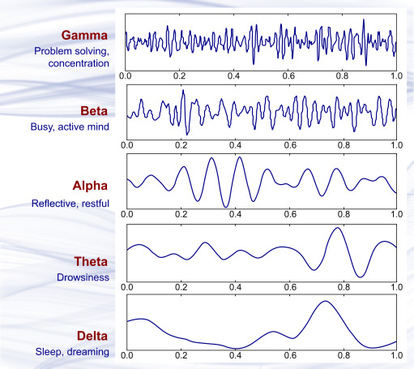
Introduction
Intellectual developmental disorder (IDD) is a condition that. affects a person's intellectual functioning and adaptive behavior. It results in limitations for daily life activities such as mobility, reasoning, thinking, communication, slow learning process, and social behavior. A person is considered to have IDD if their IQ is below 70, but the diagnosis is based on a range of factors such as ability to adapt to daily life activities, social interactions, and communication skills. IDD encompasses a range of conditions that affect a person's intellectual functioning and adaptive behavior and can vary widely in severity. Some people may need more support than others to live independently and participate in their community
The use of artificial intelligence (AI) in diagnosing mental and psychological behavior is increasing, but there are currently no notable AI-based mechanisms to aid in the diagnosis of IDD. However, imaging and signal-based techniques, such as MRI and EEG, supported by AI, are widely used to diagnose other mental disorders such as autism, epilepsy, and Parkinson's disease. Some studies, such as Sareen et al., have used EEG to study functional brain networks and found social impairment in IDD subjects. In this paper, the authors propose an AI mechanism to diagnose IDD from EEG signals. Data is collected from control and IDD subjects, and features are extracted from the signals and fed to a machine learning algorithm for classification purposes.

Slide 4
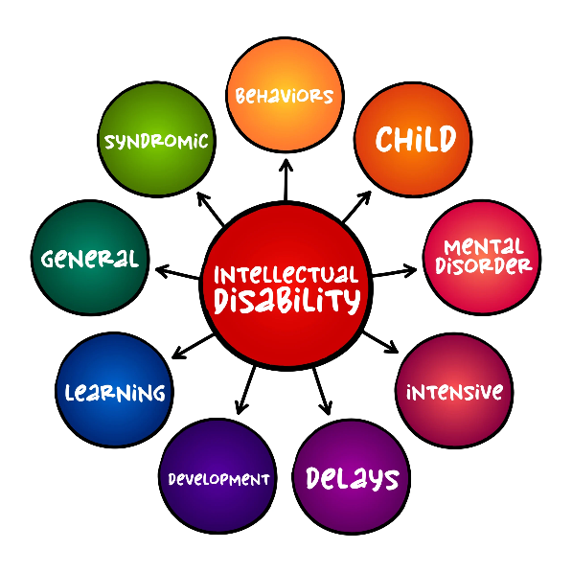
Intellectual Development Disorder
Intellectual development disorder is a condition that affects a person's cognitive abilities. This slide provides an overview of the condition and the symptoms associated with it. Early diagnosis and intervention can significantly improve outcomes for people with intellectual development disorder.

Slide 5
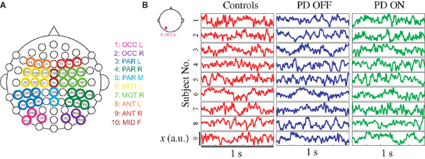
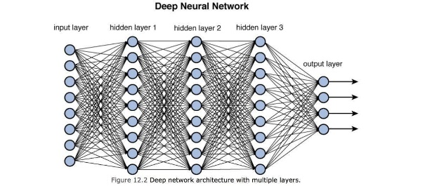
Dataset
Dataset is comprised of 14 subjects, seven subjects are diagnosed as intellectual and developmental disabled (IDD) and seven typically developing controls (TDC) subjects. The average age of IDD and TDC subjects is 28.28 ±2.05 and 21.28±1.60 respectively. Intelligence Quotient (IQ) of IDD ranges from 52 to 68 (59.143 ± 5.33) and Social Quotient (SQ) from 57 to 62 (mean SQ: 60 ± 2.08) as shown in table I. EEG signals are measured using Emotive Epoch+ with a sampling frequency of 128 Hz from 14 electrodes placed on scalp according to the 10-20 international system. Data for 2 minutes is recorded from each subject under rest condition followed by music stimuli of 2 minutes.

Slide 6
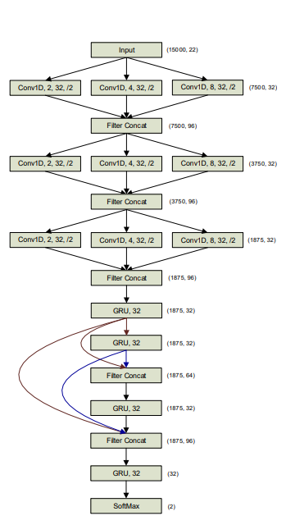
MATERIALS AND METHODS
Some of the CNN methods we are implementing include EfficientNet7, Ensemble model of the fully fine-tuned Inception V3 and DenseNet 201, Fine-tuning the Inception-ResNet-C of Inception-ResNet V2, VGG16, VGG19 along with the state of the art CNN-LSTM model referred to as Chrononet which is shown in the figure.We are also considering converting the 1-D signals into spectrograms and then applying various CNN architectures on it.u

Slide 7


Results And Discussion
We are currently implementing deep learning architectures for classification such as Resnet V2,VGG16 etc. We propose using an ensemble model consisting of the above mentioned models and ChronoNet: Inception Convolutional Densely Connected Gated Recurrent Neural
Network.
Using traditional machine algorithms,we have been able to achieve the following results.An accuracy and F1-score of 92.6% and 91.3% is achieved when music stimulus is used; otherwise,91.9% accuracy and 89.9% F1-score is achieved

Slide 8
Conclusion
The findings of the study require validation and improvement through further research. This additional study should explore the use of larger and more diverse datasets, optimize the model's architecture and parameters, and test the model in real clinical settings. The study adds to the growing body of knowledge on the application of deep learning in medical signal and image analysis and highlights the potential for these methods to revolutionize healthcare delivery and improve patient outcomes.

Slide 9



REFERENCES
ChronoNet: A Deep Recurrent Neural Network forAbnormal EEG Identification
EEG dataset of individuals with intellectual and developmental disorder and healthy controls while observing rest and musical stimulus
A Machine Learning approach for Recognizing Intellectual Development Disorder using EEG

